Slide 1
Indexing and Hashing
Instructor: Dr. Sonam Nahar

Slide 2
Indexing and Hashing
Basic Concepts
Ordered Indices
B⁺-Tree Index Files
B-Tree Index Files
Static Hashing
Dynamic Hashing
Comparison of Ordered Indexing and Hashing
Index Definition in SQL
Multiple-Key Access

Slide 3
Basic Concepts
Indexing mechanisms used to speed up random access to desired data or records in file.
  E.g., book catalog in library
Search Key - attribute or set of attributes used to look up records in a file.
An index file consists of records (called index entries) of the form
Index files are typically much smaller than the original file
Two basic kinds of indices:
  Ordered indices: search keys are stored in sorted order
  Hash indices: search keys are distributed uniformly across “buckets” using a “hash function”.
search-key
pointer

Slide 4
Index techniques Evaluation Metrics
Access types, E.g.,
  records with a specified value in the attribute
  or records with an attribute value falling in a specified range of values (e.g. 10000 < salary < 40000)
Access time
Insertion time
Deletion time
Space overhead’
A file can have more than one index i.e. multiple search keys.
Example, In a library, a book can be searched by title, author or subject.

Slide 5
Ordered Indices
An ordered index stores the values of the search key or index entries in sorted order, and associates with each search key the records that contain it.
The records in the indexed file may themselves be stored in some sorted order.
Clustering index: in a sequentially ordered file, the index whose search key specifies the sequential order of the file.
  The search key of a primary index is usually but not necessarily the primary key.
Secondary index: an index whose search key specifies an order different from the sequential order of the file. Also called
non-clustering index.
Index-sequential file: sequential ordered file with clustering index.

Slide 6
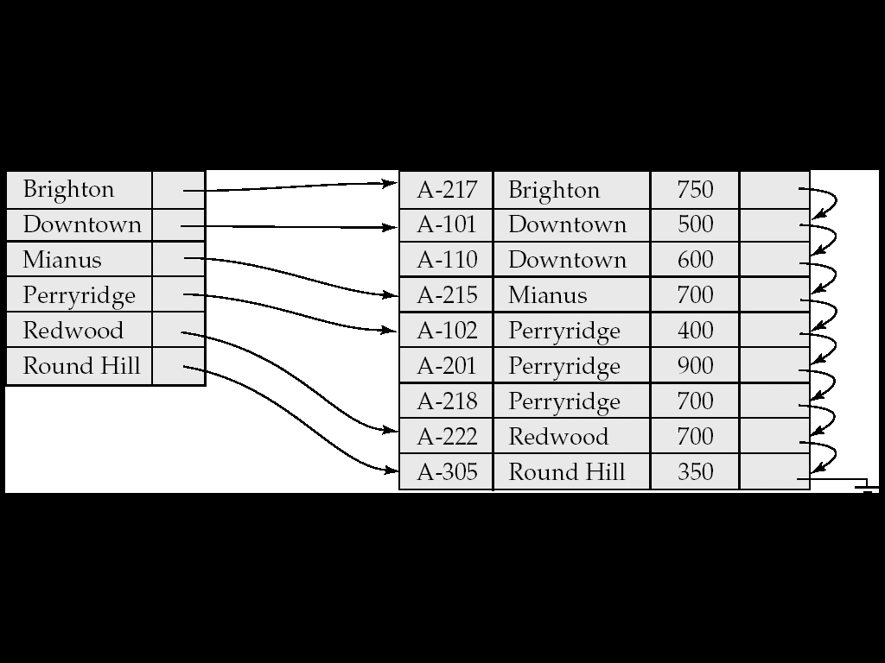
Example of a sequential file

Slide 7
Dense Index Files
Dense index — Index record appears for every search-key value in the file.
In dense clustering index, index record contains search key value and a pointer to the first data record with that search key value.
In dense, non clustering index, a list of pointers to all records is stored with the search key value.

Slide 8
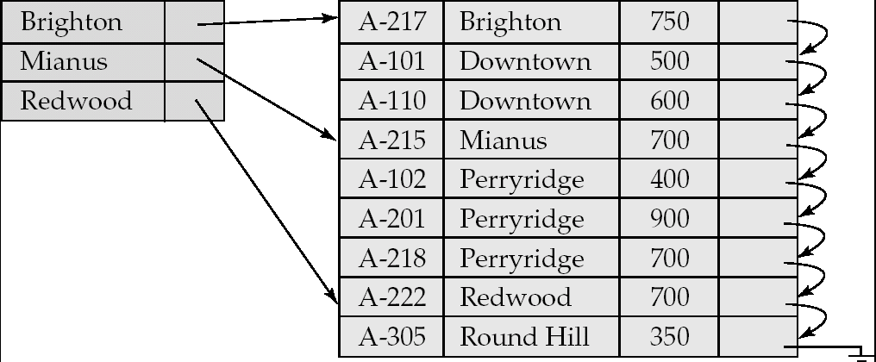
Sparse Index Files
Sparse Index: contains index records for only some search-key values.
  Applicable when records are sequentially ordered on search-key
To locate a record with search-key value K we:
  Find index record with largest search-key value < K
  Search file sequentially starting at the record to which the index record points

Slide 9
Sparse Index Files (Cont.)
Compared to dense indices:
  Less space and less maintenance overhead for insertions and deletions.
  Generally slower than dense index for locating records.
Good tradeoff: sparse index with an index entry for every block in file, corresponding to least search-key value in the block.

Slide 10
Index Update: Record Insertion
Every index must be updated whenever a record is either inserted or deleted from the file.
Perform a lookup using the key value that appears in the record to be inserted.
Dense indices –
  if the search-key value does not appear in the index, insert it at appropriate position.
  Otherwise following actions are taken:
    If the index record stores pointers to all records with the same search key value, the system adds a pointer to the new record to the index record.
    Otherwise, the index record stores a pointer to only the first record with the search key value. The system then places the record being inserted after the other records with the same search key values.

Slide 11
Index Update: Record Insertion
Sparse indices –
  if index stores an entry for each block of the file, no change needs to be made to the index unless a new block is created.
  If a new block is created, the first search-key value appearing in the new block is inserted into the index.
  On the other hand, if the record has the least search key value in its block, the system updates the index entry pointing to the block; if not, the system makes no changes to the index.

Slide 12
Index Update: Record Deletion
To delete a record, the system first looks up the record to be deleted
Dense indices –
  If deleted record was the only record in the file with its particular search-key value, the search-key is deleted from the index also.
  Otherwise the following actions are taken:
    If the index record stores pointers to all records with the same search key value, the system deletes the pointer to the deleted record from the index record.
    Otherwise, the index record stores a pointer to only the first record with the search key value. In this case, if the deleted record was the first record with the search key value, the system updates the index record to point to the next record.

Slide 13
Index Update: Record Deletion
  Sparse indices –
    If the index does not contain an index entry with the search-key value of the deleted record, nothing needs to be done to the index.
    Otherwise the system takes the following actions:
      If the deleted record was the only record with its search key, the system replaces the corresponding index record with an index record for the next search-key value (in search-key order). If the next search-key value already has an index entry, the entry is deleted instead of being replaced.
      Otherwise, if the index entry for the search-key value points to the record being deleted, the system updates the index entry to point to the next record with the same search-key value.

Slide 14
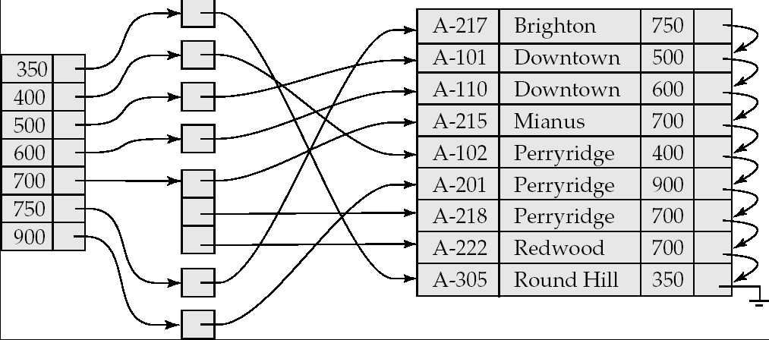
Secondary Indices Example
Secondary index on balance field of account
Index record points to a bucket that contains pointers to all the actual records with that particular search-key value.
Secondary indices have to be dense, with an index entry for every serch key value , and a pointer to every record in the file.

Slide 15
Primary and Secondary Indices
Indices offer substantial benefits when searching for records.
BUT: Updating indices imposes overhead on database modification --when a file is modified, every index on the file must be updated,
Sequential scan using primary index is efficient, but a sequential scan using a secondary index is expensive
  Each record access may fetch a new block from disk
  Block fetch requires about 5 to 10 micro seconds, versus about 100 nanoseconds for memory access

Slide 16
Multilevel Index
If primary index does not fit in memory, access becomes expensive.
Solution: treat primary index kept on disk as a sequential file and construct a sparse index on it.
  outer index – a sparse index of clustering index
  inner index – the clustering index file
If even outer index is too large to fit in main memory, yet another level of index can be created, and so on.
Indices at all levels must be updated on insertion or deletion from the file.
Multilevel insertion (as well as deletion) algorithms are simple extensions of the single-level algorithms

Slide 17
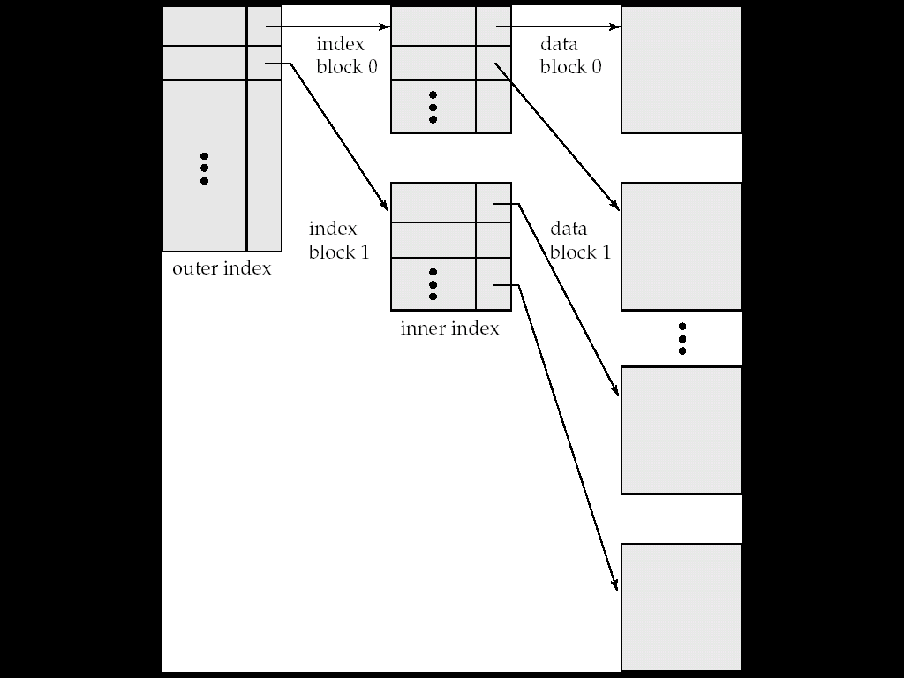
Multilevel Index (Cont.)
To locate a record, we first use binary search on outer index to find record for the largest search key value less than or equal to that one we desire.
The pointer points to a block of inner index.
We scan this block until we find the record that has the largest search-key value less than or equal to the one that we desire. The pointer in this record points to the block of the file that contains the record for which we are looking

Slide 18
B⁺-Tree Index Files
B⁺-tree indices are an alternative to indexed-sequential files.
Disadvantage of indexed-sequential files
  performance degrades as file grows, since many overflow blocks get created.
  Periodic reorganization of entire file is required.
Advantage of B⁺-tree index files:
  automatically reorganizes itself with small, local, changes, in the face of insertions and deletions.
  Reorganization of entire file is not required to maintain performance.
(Minor) disadvantage of B⁺-trees:
  extra insertion and deletion overhead, space overhead.
Advantages of B⁺-trees outweigh disadvantages
  B⁺-trees are used extensively

Slide 19
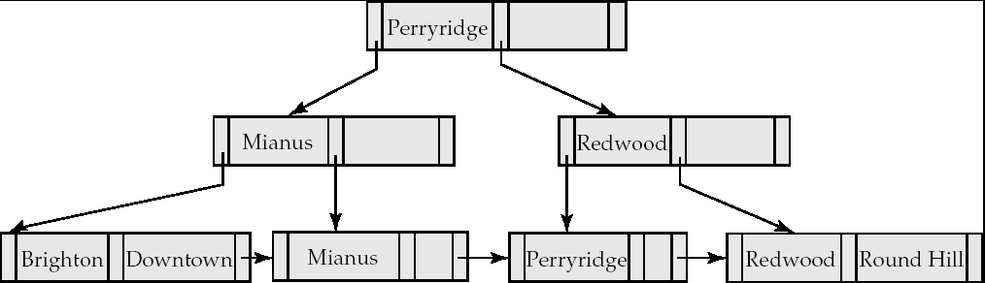
B⁺-Tree Index Files (Cont.)
A B⁺-tree is a rooted tree satisfying the following properties:
All paths from root to leaf are of the same length
Each node that is not a root or a leaf has between ⎡n/2⎤ and n children.
A leaf node has between ⎡(n–1)/2⎤ and n–1 values
Special cases:
  If the root is not a leaf, it has at least 2 children.
  If the root is a leaf (that is, there are no other nodes in the tree), it can have between 0 and (n–1) values.

Slide 20
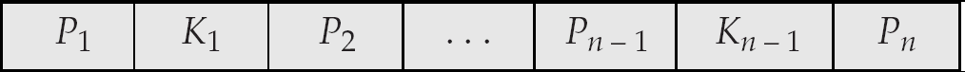
B⁺-Tree Node Structure
Typical node
  K_{i} are the search-key values
  P_{i} are pointers to children (for non-leaf nodes) or pointers to records or buckets of records (for leaf nodes).
The search-keys in a node are ordered
K₁ < K₂ < K₃ < . . . < K_{n–1}

Slide 21
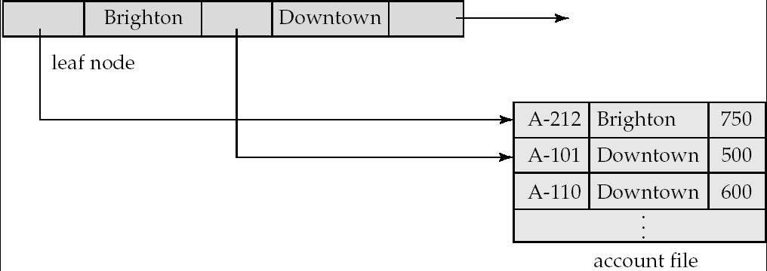
Leaf Nodes in B⁺-Trees
Properties of a leaf node:
For i = 1, 2, . . ., n–1, pointer P_{i} either points to a file record with search-key value K_{i}, or to a bucket of pointers to file records, each record having search-key value K_{i}. Only need bucket structure if search-key does not form a primary key.
If L_{i}, L_{j} are leaf nodes and i < j, L_{i}’s search-key values are less than L_{j}’s search-key values
P_{n} points to next leaf node in search-key order

Slide 22
Non-Leaf Nodes in B⁺-Trees
Non leaf nodes form a multi-level sparse index on the leaf nodes. For a non-leaf node with m pointers:
  All the search-keys in the subtree to which P₁ points are less than K₁
  For 2 ≤ i ≤ n – 1, all the search-keys in the subtree to which P_{i} points have values greater than or equal to K_{i–1} and less than K_{i}
  All the search-keys in the subtree to which P_{n} points have values greater than or equal to K_{n–1}

Slide 23
Example of a B⁺-tree
B⁺-tree for account file (n = 3)

Slide 24
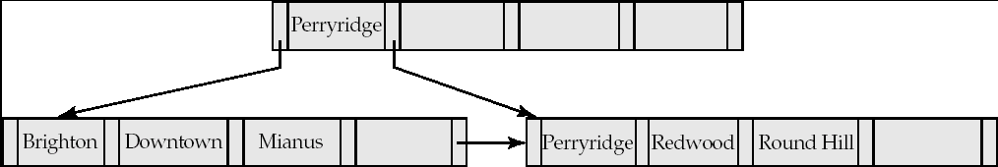
Example of B⁺-tree
B⁺-tree for account file (n = 5)
Leaf nodes must have between 2 and 4 values
(⎡(n–1)/2⎤ and n –1, with n = 5).
Non-leaf nodes other than root must have between 3 and 5 children (⎡(n/2⎤ and n with n =5).
Root must have at least 2 children.

Slide 25
Observations about B⁺-trees
Since the inter-node connections are done by pointers, “logically” close blocks need not be “physically” close.
The non-leaf levels of the B⁺-tree form a hierarchy of sparse indices.
The B⁺-tree contains a relatively small number of levels
    Level below root has at least 2* ⎡n/2⎤ values
    Next level has at least 2* ⎡n/2⎤ * ⎡n/2⎤ values
    .. etc.
  If there are K search-key values in the file, the tree height is no more than ⎡ log_{⎡n/2⎤}(K)⎤
  thus searches can be conducted efficiently.
Insertions and deletions to the main file can be handled efficiently, as the index can be restructured in logarithmic time (as we shall see).

Slide 26
Queries on B⁺-Trees
Find all records with a search-key value of k.
  N=root
  Repeat
    Examine N for the smallest search-key value > k.
    If such a value exists, assume it is K_{i}. Then set N = P_{i}
    Otherwise k ≥ K_{n–1}. Set N = P_{n}
    Until N is a leaf node
  If for some i, key K_{i} = k follow pointer P_{i} to the desired record or bucket.
  Else no record with search-key value k exists.

Slide 27
Queries on B⁺⁻Trees (Cont.)
If there are K search-key values in the file, the height of the tree is no more than ⎡log_{⎡n/2⎤}(K)⎤.
A node is generally the same size as a disk block, typically 4 kilobytes
  and n is typically around 100 (40 bytes per index entry).
With 1 million search key values and n = 100
  at most log₅₀(1,000,000) = 4 nodes are accessed in a lookup.
Contrast this with a balanced binary tree with 1 million search key values — around 20 nodes are accessed in a lookup
  above difference is significant since every node access may need a disk I/O, costing around 20 milliseconds

Slide 28
Updates on B⁺-Trees: Insertion
Find the leaf node in which the search-key value would appear
If the search-key value is already present in the leaf node
  Add record to the file
If the search-key value is not present, then
  add the record to the main file (and create a bucket if necessary)
  If there is room in the leaf node, insert (key-value, pointer) pair in the leaf node
  Otherwise, split the node (along with the new (key-value, pointer) entry) as discussed in the next slide.

Slide 29
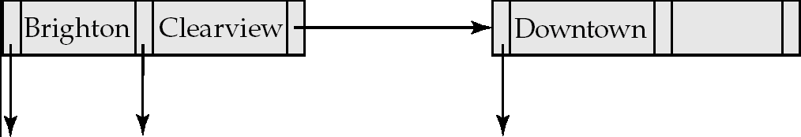
Updates on B⁺-Trees: Insertion (Cont.)
Splitting a leaf node:
  take the n (search-key value, pointer) pairs (including the one being inserted) in sorted order. Place the first ⎡n/2⎤ in the original node, and the rest in a new node.
  let the new node be p, and let k be the least key value in p. Insert (k,p) in the parent of the node being split.
  If the parent is full, split it and propagate the split further up.
Splitting of nodes proceeds upwards till a node that is not full is found.
  In the worst case the root node may be split increasing the height of the tree by 1.
Result of splitting node containing Brighton and Downtown on inserting Clearview
Next step: insert entry with (Downtown,pointer-to-new-node) into parent

Slide 30

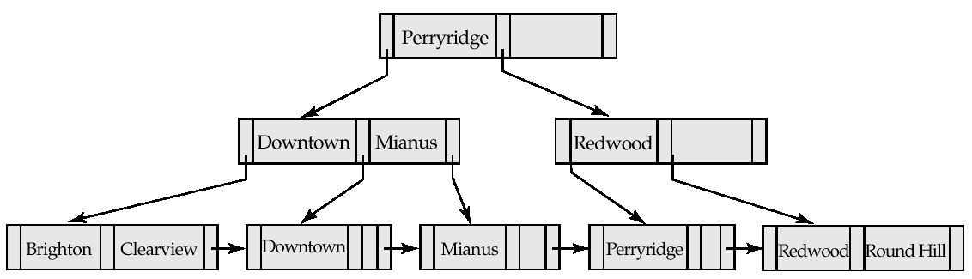
Updates on B⁺-Trees: Insertion (Cont.)
B⁺-Tree before and after insertion of “Clearview”

Slide 31
Insertion in B⁺-Trees (Cont.)
Splitting a non-leaf node: when inserting (k,p) into an already full internal node N
  Copy N to an in-memory area M with space for n+1 pointers and n keys
  Insert (k,p) into M
  Copy P₁,K₁, …, K _{⎡n/2⎤-1},P _{⎡n/2⎤} from M back into node N
  Copy P_{⎡n/2⎤+1},K _{⎡n/2⎤+1},…,K_{n},P_{n+1} from M into newly allocated node N’
  Insert (K _{⎡n/2⎤},N’) into parent N
Read pseudocode in book!
Mianus
Downtown Mianus Perryridge
Downtown
Redwood

Slide 32
Updates on B⁺-Trees: Deletion
Find the record to be deleted, and remove it from the main file and from the bucket (if present)
Remove (search-key value, pointer) from the leaf node if there is no bucket or if the bucket has become empty
If the node has too few entries due to the removal, and the entries in the node and a sibling fit into a single node, then merge siblings:
  Insert all the search-key values in the two nodes into a single node (the one on the left), and delete the other node.
  Delete the pair (K_{i–1}, P_{i}), where P_{i} is the pointer to the deleted node, from its parent, recursively using the above procedure.

Slide 33
Updates on B⁺-Trees: Deletion
Otherwise, if the node has too few entries due to the removal, but the entries in the node and a sibling do not fit into a single node, then redistribute pointers:
  Redistribute the pointers between the node and a sibling such that both have more than the minimum number of entries.
  Update the corresponding search-key value in the parent of the node.
The node deletions may cascade upwards till a node which has ⎡n/2⎤ or more pointers is found.
If the root node has only one pointer after deletion, it is deleted and the sole child becomes the root.

Slide 34

Examples of B⁺-Tree Deletion
Before and after deleting “Downtown”
Deleting “Downtown” causes merging of under-full leaves
  leaf node can become empty only for n=3!

Slide 35
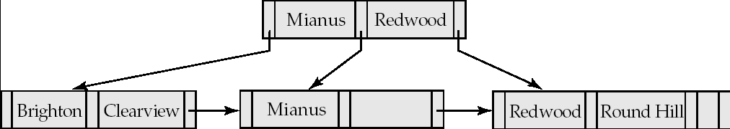
Examples of B⁺-Tree Deletion (Cont.)
Before and After deletion of “Perryridge” from result of previous example

Slide 36
Examples of B⁺-Tree Deletion (Cont.)
Leaf with “Perryridge” becomes underfull (actually empty, in this special case) and merged with its sibling.
As a result “Perryridge” node’s parent became underfull, and was merged with its sibling
  Value separating two nodes (at parent) moves into merged node
  Entry deleted from parent
Root node then has only one child, and is deleted

Slide 37
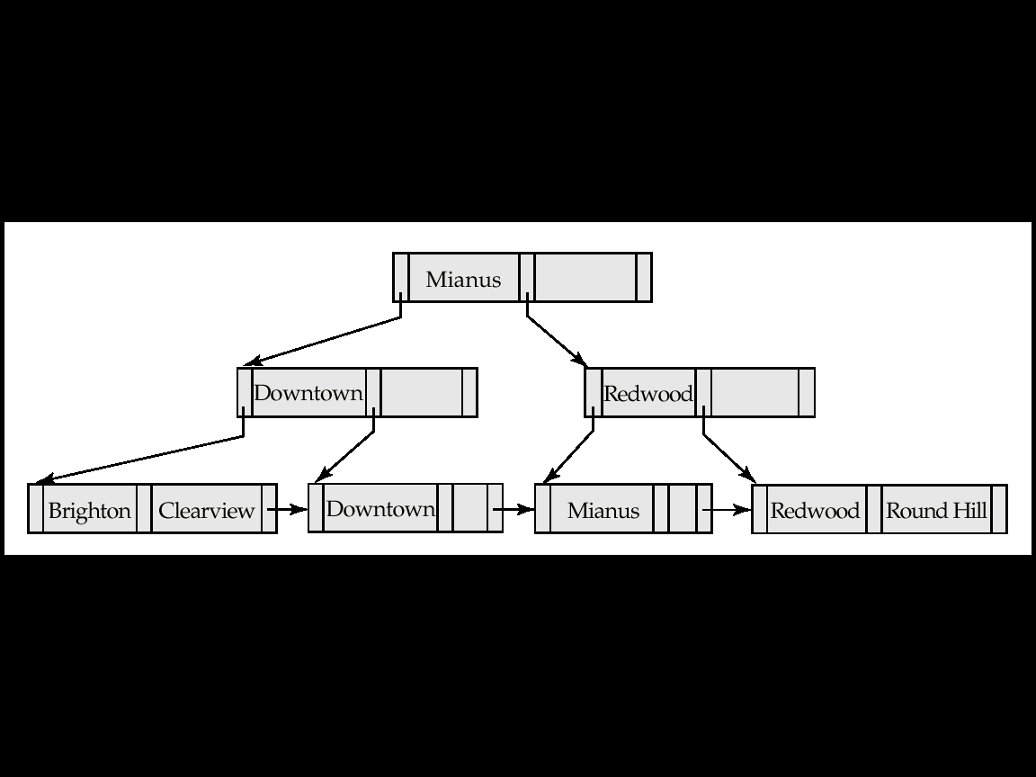
Example of B⁺-tree Deletion (Cont.)
Before and after deletion of “Perryridge” from earlier example
Parent of leaf containing Perryridge became underfull, and borrowed a pointer from its left sibling
Search-key value in the parent’s parent changes as a result

Slide 38
B⁺-Tree File Organization
Index file degradation problem is solved by using B⁺-Tree indices.
Data file degradation problem is solved by using B⁺-Tree File Organization.
The leaf nodes in a B⁺-tree file organization store records, instead of pointers.
Leaf nodes are still required to be half full
  Since records are larger than pointers, the maximum number of records that can be stored in a leaf node is less than the number of pointers in a nonleaf node.
Insertion and deletion are handled in the same way as insertion and deletion of entries in a B⁺-tree index.

Slide 39
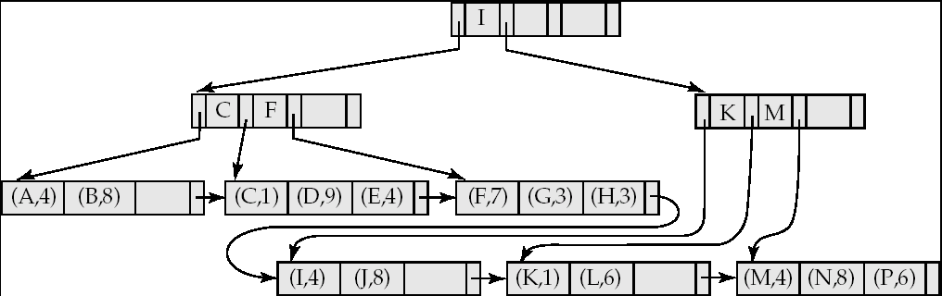

B⁺-Tree File Organization (Cont.)
Example of B⁺-tree File Organization
Good space utilization important since records use more space than pointers.
To improve space utilization, involve more sibling nodes in redistribution during splits and merges
  Involving 2 siblings in redistribution (to avoid split / merge where possible) results in each node having at least entries

Slide 40
Hashing

Slide 41
Static Hashing
A bucket is a unit of storage containing one or more records (a bucket is typically a disk block).
In a hash file organization we obtain the bucket of a record directly from its search-key value using a hash function.
Hash function h is a function from the set of all search-key values K to the set of all bucket addresses B.
Hash function is used to locate records for access, insertion as well as deletion.
Records with different search-key values may be mapped to the same bucket; thus entire bucket has to be searched sequentially to locate a record.

Slide 42
Example of Hash File Organization
Hash file organization of account file, using branch_name as key
(See figure in next slide.)
There are 10 buckets,
The binary representation of the ith character is assumed to be the integer i.
The hash function returns the sum of the binary representations of the characters modulo 10
  E.g. h(Perryridge) = 5 h(Round Hill) = 3 h(Brighton) = 3

Slide 43
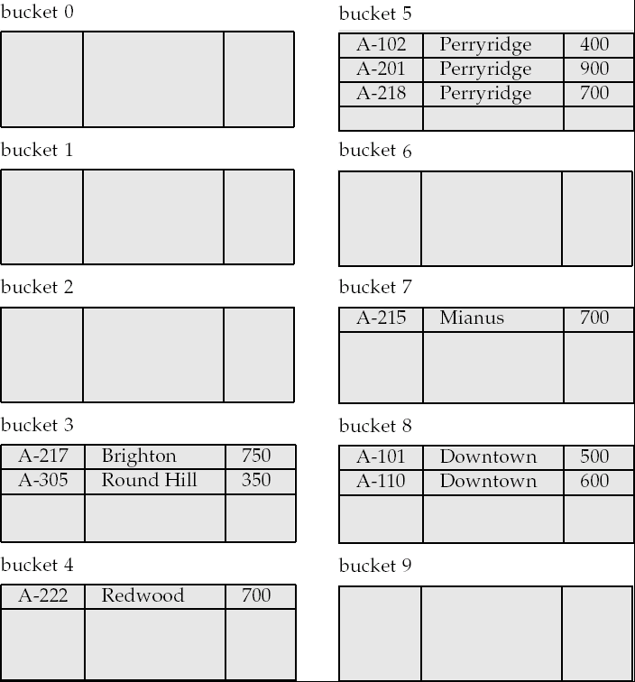
Example of Hash File Organization
Hash file organization of account file, using branch_name as key
(see previous slide for details).

Slide 44
Hash Functions
Worst hash function maps all search-key values to the same bucket; this makes access time proportional to the number of search-key values in the file.
An ideal hash function is uniform, i.e., each bucket is assigned the same number of search-key values from the set of all possible values.
Ideal hash function is random, so each bucket will have the same number of records assigned to it irrespective of the actual distribution of search-key values in the file.
Typical hash functions perform computation on the internal binary representation of the search-key.
  For example, for a string search-key, the binary representations of all the characters in the string could be added and the sum modulo the number of buckets could be returned. .

Slide 45
Handling of Bucket Overflows
Bucket overflow can occur because of
  Insufficient buckets
  Skew in distribution of records. This can occur due to two reasons:
    multiple records have same search-key value
    chosen hash function produces non-uniform distribution of key values
Although the probability of bucket overflow can be reduced, it cannot be eliminated; it is handled by using overflow buckets.

Slide 46
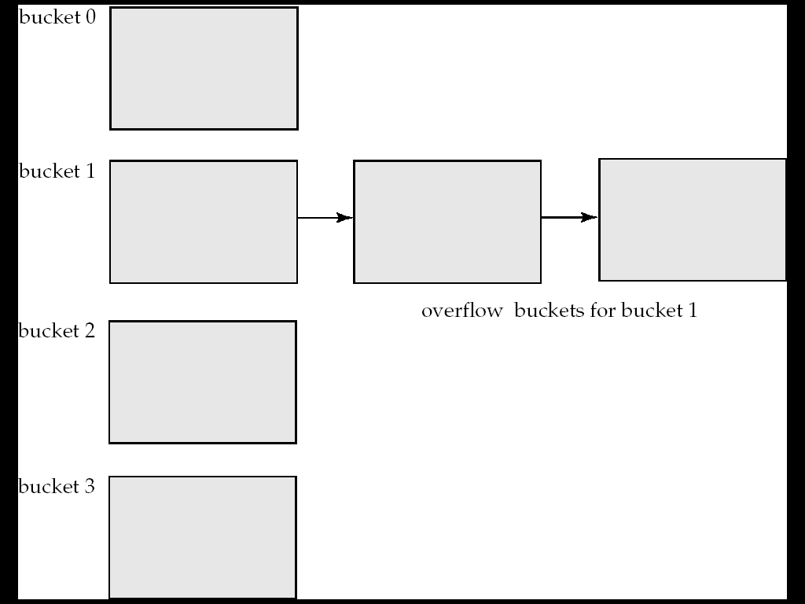
Handling of Bucket Overflows (Cont.)
Overflow chaining – the overflow buckets of a given bucket are chained together in a linked list.
Above scheme is called closed hashing.
  An alternative, called open hashing, which does not use overflow buckets, is not suitable for database applications.

Slide 47
Hash Indices
Hashing can be used not only for file organization, but also for index-structure creation.
A hash index organizes the search keys, with their associated record pointers, into a hash file structure.
Strictly speaking, hash indices are always secondary indices
  if the file itself is organized using hashing, a separate primary hash index on it using the same search-key is unnecessary.
  However, we use the term hash index to refer to both secondary index structures and hash organized files.

Slide 48
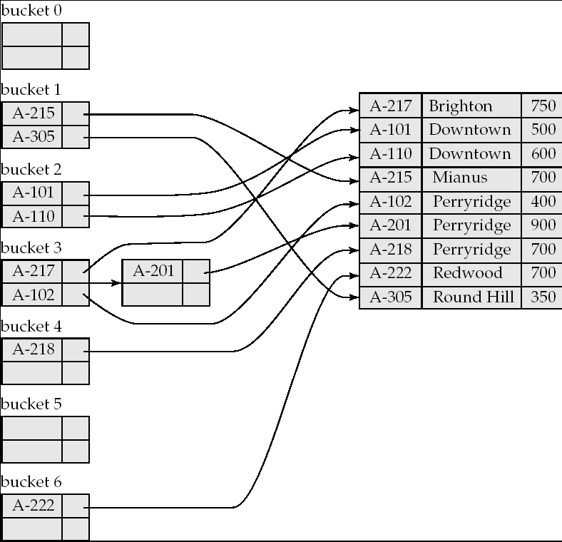
Example of Hash Index

Slide 49
Deficiencies of Static Hashing
In static hashing, function h maps search-key values to a fixed set of B of bucket addresses. Databases grow or shrink with time.
  If initial number of buckets is too small, and file grows, performance will degrade due to too much overflows.
  If space is allocated for anticipated growth, a significant amount of space will be wasted initially (and buckets will be underfull).
  If database shrinks, again space will be wasted.
One solution: periodic re-organization of the file with a new hash function
  Expensive, disrupts normal operations
Better solution: allow the number of buckets to be modified dynamically.

Slide 50
Dynamic Hashing
Good for database that grows and shrinks in size
Allows the hash function to be modified dynamically
Extendable hashing – one form of dynamic hashing
  Hash function generates values over a large range — typically b-bit integers, with b = 32.
  At any time use only a prefix of the hash function to index into a table of bucket addresses.
  Let the length of the prefix be i bits, 0 ≤ i ≤ 32.
    Bucket address table size = 2^{i.} Initially i = 0
    Value of i grows and shrinks as the size of the database grows and shrinks.
  Multiple entries in the bucket address table may point to a bucket
  Thus, actual number of buckets is < 2^{i}
    The number of buckets also changes dynamically due to coalescing and splitting of buckets.

Slide 51
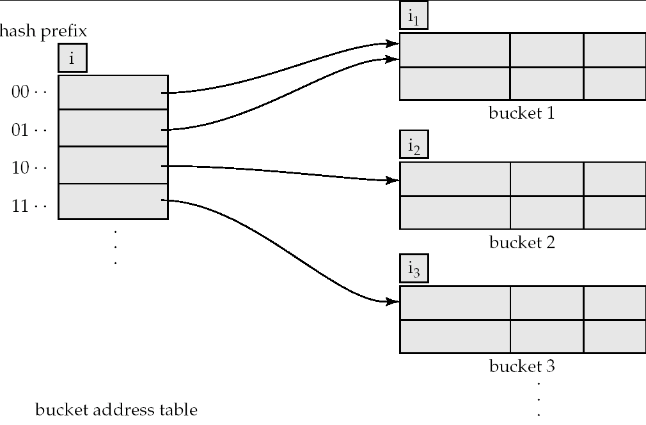
General Extendable Hash Structure
In this structure, i₂ = i₃ = i, whereas i₁ = i – 1 (see next slide for details)

Slide 52
Use of Extendable Hash Structure
Each bucket j stores a value i_{j}
  All the entries that point to the same bucket have the same values on the first i_{j} bits.
To locate the bucket containing search-key K_{j}:
  1. Compute h(K_{j}) = X
  2. Use the first i high order bits of X as a displacement into bucket address table, and follow the pointer to appropriate bucket
To insert a record with search-key value K_{j}
  follow same procedure as look-up and locate the bucket, say j.
  If there is room in the bucket j insert record in the bucket.
  Else the bucket must be split and insertion re-attempted (next slide.)
    Overflow buckets used instead in some cases (will see shortly)

Slide 53
Insertion in Extendable Hash Structure (Cont)
To split a bucket j when inserting record with search-key value K_{j}:
If i > i_{j} (more than one pointer to bucket j)
  allocate a new bucket z, and set i_{j} = i_{z} = (i_{j} + 1)
  Update the second half of the bucket address table entries originally pointing to j, to point to z
  remove each record in bucket j and reinsert (in j or z)
  recompute new bucket for K_{j} and insert record in the bucket (further splitting is required if the bucket is still full)
If i = i_{j} (only one pointer to bucket j)
  If i reaches some limit b, or too many splits have happened in this insertion, create an overflow bucket
  Else
    increment i and double the size of the bucket address table.
    replace each entry in the table by two entries that point to the same bucket.
    recompute new bucket address table entry for K_{j}
    Now i > i_{j} so use the first case above.

Slide 54
Deletion in Extendable Hash Structure
To delete a key value,
  locate it in its bucket and remove it.
  The bucket itself can be removed if it becomes empty (with appropriate updates to the bucket address table).
  Coalescing of buckets can be done (can coalesce only with a “buddy” bucket having same value of i_{j} and same i_{j} –1 prefix, if it is present)
  Decreasing bucket address table size is also possible
    Note: decreasing bucket address table size is an expensive operation and should be done only if number of buckets becomes much smaller than the size of the table

Slide 55
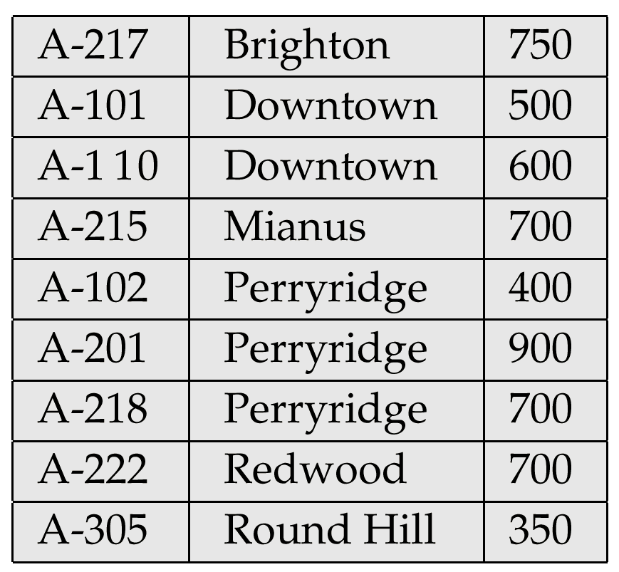
Sample account File

Slide 56
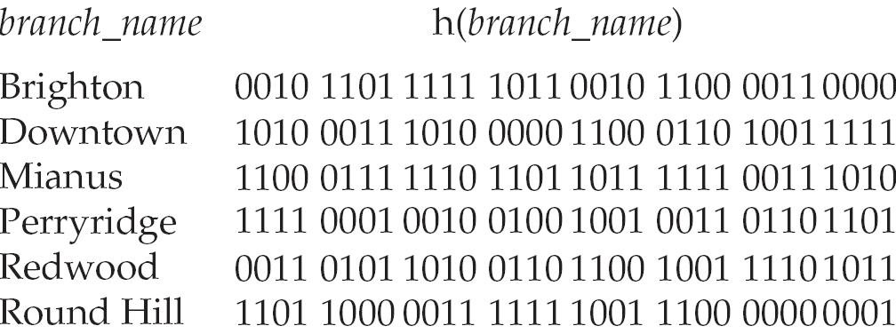
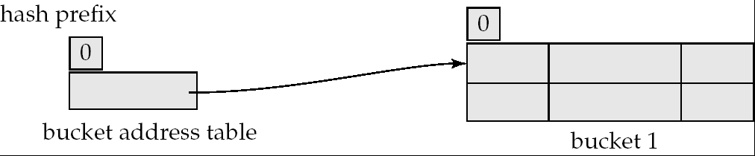
Use of Extendable Hash Structure: Example
Initial Hash structure, bucket size = 2

Slide 57
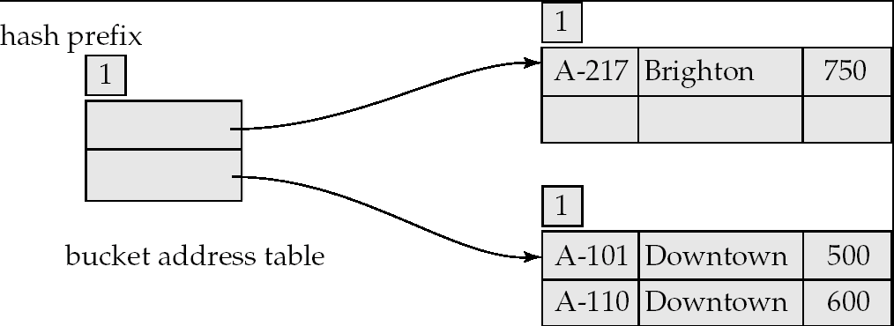
Example (Cont.)
Hash structure after insertion of one Brighton and two Downtown records

Slide 58
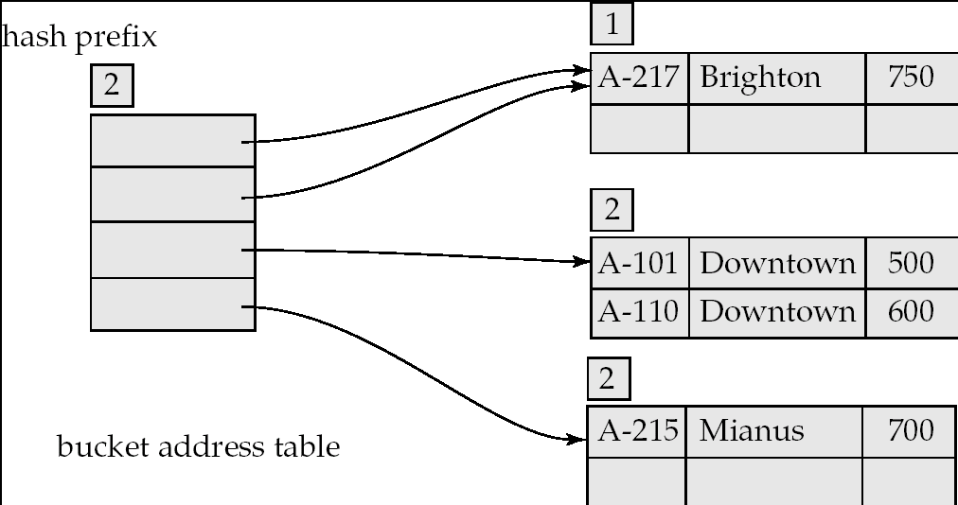
Example (Cont.)
Hash structure after insertion of Mianus record

Slide 59
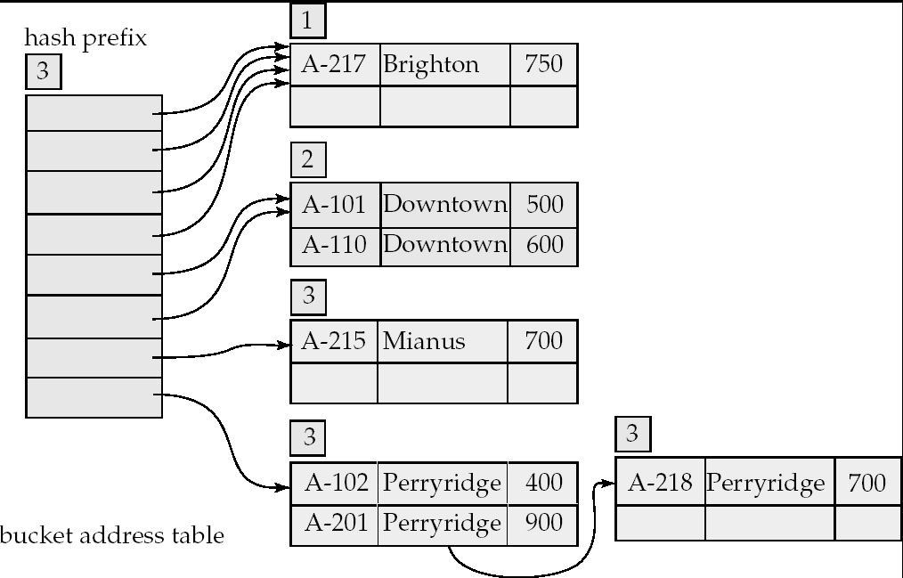
Example (Cont.)
Hash structure after insertion of three Perryridge records

Slide 60
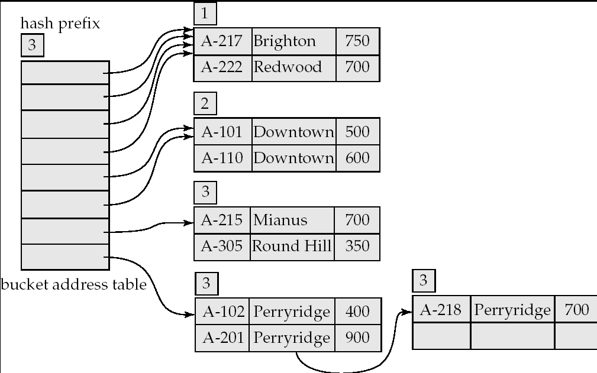
Example (Cont.)
Hash structure after insertion of Redwood and Round Hill records

Slide 61
Extendable Hashing vs. Other Schemes
Benefits of extendable hashing:
  Hash performance does not degrade with growth of file
  Minimal space overhead
Disadvantages of extendable hashing
  Extra level of indirection to find desired record
  Bucket address table may itself become very big (larger than memory)
    Cannot allocate very large contiguous areas on disk either
    Solution: B⁺-tree file organization to store bucket address table
  Changing size of bucket address table is an expensive operation
Linear hashing is an alternative mechanism
  Allows incremental growth of its directory (equivalent to bucket address table)
  At the cost of more bucket overflows

Slide 62
Comparison of Ordered Indexing and Hashing
Cost of periodic re-organization
Relative frequency of insertions and deletions
Is it desirable to optimize average access time at the expense of worst-case access time?
Expected type of queries:
  Hashing is generally better at retrieving records having a specified value of the key.
  If range queries are common, ordered indices are to be preferred
In practice:
  PostgreSQL supports hash indices, but discourages use due to poor performance
  Oracle supports static hash organization, but not hash indices
  SQLServer supports only B⁺-trees

Slide 63
Index Definition in SQL
Create an index
  create index <index-name> on <relation-name>
  (<attribute-list>)
  E.g.: create index b-index on branch(branch_name)
Use create unique index to indirectly specify and enforce the condition that the search key is a candidate key is a candidate key.
  Not really required if SQL unique integrity constraint is supported
To drop an index
  drop index <index-name>
Most database systems allow specification of type of index, and clustering.

